Slide 1
ADOP CARTRIDGES
DAY 10

Slide 2
AGENDA
What is Accenture DevOps Platform (ADOP)?
What is a Cartridge?
Development Guidelines
Utilize the Cartridge Development cartridge
Develop the Cartridge content
Test the cartridge against the platform
DEMO
Q&A

Slide 3



What is DevOps? Brief Overview
practice of operations and development engineers
DevOps
involved in the entire service lifecycle
hastens the delivery and integration of processes
How DevOps Principles Accelerate Software Delivery
“DevOps uses automation techniques to optimize collaboration across development and operations, enabling faster, more predictable and more frequent deployments to market"
Development
Operations
Test early and often
Improve continuously
Automate everything
Cohesive teams
Strong source control
Deliver small increments
Experiment frequently without regret
Traditional Development
For Internal Use Only
Notes:
Developer is the one that writes code for new products, new features, security updates, and bug fixes.
Operations team is responsible for maintaining and assuring the uptime of the production environments.
DevOps integrates developers and operations teams in order to improve collaboration and productivity by automating infrastructure, automating workflows and continuously measuring application performance.

Slide 4
What is a Accenture DevOps Platform (ADOP)?
a framework that glues together a suite of open source development tools
provides a really quick way of mobilizing software development projects in a consistent way, using a standard set of tools and processes.
The framework can be configured for use for a particular technology using a ‘cartridge’.
a set of Docker-composed templates which provision a suite of DevOps tools.
Cartridges are imported into the platform using Jenkins jobs embedded within the base Jenkins component.
Functionally
Technically
Notes:
Functionally, ADOP is a framework that glues together a suite of open source development tools and provides a really quick way of mobilizing software development projects in a consistent way, using a standard set of tools and processes (for example, Continuous Delivery). The framework can be configured for use for a particular technology using a ‘cartridge’.
Technically, ADOP is a set of Docker-composed templates which provision a suite of DevOps tools. Cartridges are imported into the platform using Jenkins jobs embedded within the base Jenkins component.

Slide 5
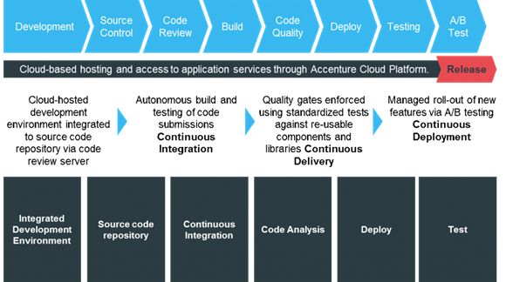
What is a Accenture DevOps Platform (ADOP)?
What problem does it solve?
Notes:
The DevOps team at Accenture support a large number of diverse engagements, for typically large enterprise clients. Our goal is that a majority of our projects use a development process and pipeline that look something like this:
To do this well requires projects to both set up tooling and adopt appropriate working practices. If engagements can be encouraged to use DevOps from the outset, it’s far easier than trying to retrospectively apply these practices. This is where the DevOps platform gives us an edge—it not only swiftly stands up a project development environment which is already configured to use recommended practices with low-cost, rapid mobilization but also helps start the engagement on the right track to a DevOps-enabled delivery.
Actually for Accenture, the objective is deeper than that. We want to be able to spin up a project development environment quickly; and also make it reflect our corporate (and now community) body of knowledge on how to best deliver a particular technology. We have a large number of engagements active at any one point, and we want to be able to bring the right assets to each engagement.

Slide 6
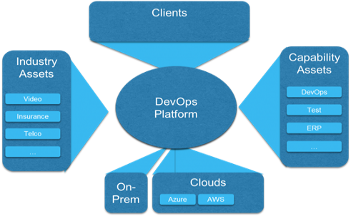
What is a Accenture DevOps Platform (ADOP)?
What problem does it solve?
Notes:
This is where cartridges come in; the idea being that a cartridge contains a reference application for a particular technology along with appropriate configuration for the chosen tools. The vision is that an ADOP cartridge may contain not just DevOps assets, but also those from other capabilities and also from industry segments (a great example is Accenture Video Solutions).
Cartridges are currently a concept at Minimum Viable Product; and can contain git repositories and Jenkins configuration. The vision is that we would extend this to the full product set.

Slide 7
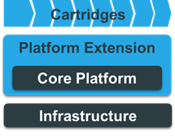
What is a Cartridge?
A cartridge is a standardized approach of packaging and sharing reusable software delivery assets.
They will typically defines the Git repositories with sample code, Jenkins jobs and pipelines that define a reference implementation for a particular technology.
Cartridges can be loaded into the platform dynamically at any time and multiple cartridges can be loaded concurrently.
They are designed for modularity and reuse and as a means for people to contribute to the platform.
Cartridges are defined according to the cartridge specification which is implemented by the cartridge skeleton which can be used as a basis for cartridge development.
The architecture is based on three (perhaps three and a half layers).

Slide 8

















ADOP Architecture Technical Overview
Amazon Web Services
Virtual Private Cloud
Cartridges
ADOP EC2 Instance
Docker Engine
Platform Extension
docker
container
Core Platform
Infrastructure
docker
container
docker
container
docker
container
docker
container
The architecture is based on three (perhaps three and a half layers).
docker
container
docker
container
docker
container
docker
container
Chef EC2 Instance
For Internal Use Only

Slide 9
Developing - Cartridge
Spin up ADOP
Read the development guidelines
Read about the cartridge architecture
Utilize the Cartridge Development cartridge
Develop the cartridge content
Test the cartridge against the platform

Slide 10
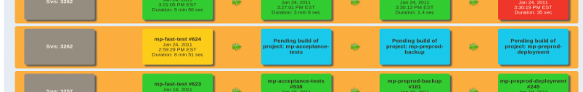
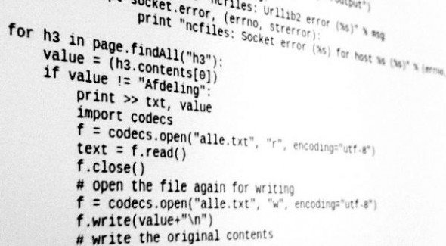
Development Guidelines
When developing a cartridge, it is advisable to follow the guidelines below in order to develop stable, secure and standardized cartridges.
Jenkins Pipeline
Source code

Slide 11
Development Guidelines - Jenkins Pipeline
High-level guidelines for writing Jenkins jobs in Job DSL:
Build Wrappers
Ensure that you are using the preBuildCleanup() wrapper in your Job DSL to make sure that your Jenkins workspace is cleared before every build.
Do not make any credentials visible anywhere in your job i.e. do not echo passwords in your shell script or store credentials as plain-text build parameters. Ensure you are always using the maskPasswords() and injectPasswords() wrappers in your Job DSL.
Credentials can also be added manually to the Jenkins credential store and then referenced in your job.
It is highly recommended that the sshAgent() wrapper be used with the Jenkins credentials specified in order to allow Jenkins to clone all local git repositories from Gerrit over SSH.
Notes:
When developing a cartridge, it is recommended that Job DSL be used in favor of XML to write your Jenkins jobs. If your cartridge only uses Job DSL a cartridge can be loaded multiple times without having to create a new project. However, if your cartridge loads XML then the jobs will need to be removed in order to reload the cartridge.

Slide 12
Development Guidelines - Jenkins Pipeline
Git SCM
Ensure that all your git clones are over SSH (not HTTPS) using the Jenkins SCM plugin (it is advisable not to do any git clones in your shell script unless specifically required to do so).
When cloning from external git repositories, ensure that you only clone from trusted git repositories.
When cloning a git repository, it better to clone using a reference rather than a branch specifier. The way to do this is by specifying the variable $GERRIT_NEWREV in the “Branch Specifier” variable. This is useful in the case of jobs that need to be rebuilt, and it is preferred that the code from that specific build be cloned as opposed to the latest code on a specific branch.
Miscellaneous
It is preferable to set your jobs to build on the Jenkins slave as opposed to the Jenkins master.
It is advisable to set up Log Rotation in order to discard old builds and artifacts so as to not occupy unnecessary space on the server. This can be implemented via the logRotator() option in Job DSL.

Slide 13
Development Guidelines - Jenkins Pipeline
The table below lists some useful Job DSL functions to use when writing your Jenkins jobs:
Job DSL Method | Function
label() | Allows you to specify a slave label where the job will be built
preBuildCleanup() | Clears Jenkins job workspace before every build
injectPasswords() | Allows you to inject global Jenkins credentials as well as your custom-defined credentials into the job
maskPasswords() | Hides the injected passwords so that they are not visible in plan text
sshAgent() | Specify SSH credentials to be used when cloning from repositories over SSH
scm() | Define a repository and a branch specifier to clone
triggers() | Specify an event (e.g. Gerrit trigger) to start a job
steps() | Build steps to execute e.g. shell(), SonarQube()
publishers() | List the post-build actions to execute after build steps have completed

Slide 14
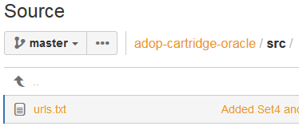
Development Guidelines - Source Code
The src folder in a cartridge will contain a single urls.txt file which will contain a list of clone urls for source code git repositories to be loaded in during cartridge creation.
It is advisable to use this file to load any repositories containing any source code as opposed to manually creating the repositories in Gerrit and then configuring manually configuring your Jenkins jobs to clone from the created repository.
The repositories must be cloned over HTTPS from the specified repository browsers (Github, BitBucket, etc.) and they must be publicly accessible. If this is not the case, the cartridge loader will fail to load the repositories. If the urls provided are SSH clone urls, then the Jenkins SSH key must be added to the relevant repository browser.

Slide 15
Using the Cartridge Development cartridge
This development cartridge allows you to load a cartridge template, creates a repository for it in Gerrit, load your cartridge from Gerrit, validate it and then publish it to an external Git repository host.
To use it:
Create a project to load the cartridge
Ideally create a new project within a new workspace
Select “adop-cartridge-cartridge-dev” when loading the cartridge
Run the CreateNewCartridge job in Jenkins which will create a repository in Gerrit
Clone the Gerrit repository and add the cartridge content
When the cartridge is ready, you may validate it using the ValidateCartridgeRepo job in Jenkins
To test the functionality of the cartridge, you may use LoadDevCartridge to load an instance of your cartridge into your ADOP Core
When you are satisfied with the content and functionality of your cartridge, you may use PublishCartridgeRepo to push your cartridge to an external Git repository

Slide 16
Developing Cartridge Content
Source Code
A cartridge will typically contain a reference application, and optional supporting repositories. In an ideal world all content relating to a component should be versioned in the same place, however this may not always be possible (e.g. if the reference application is owned by someone else) or practical.
As a bare minimum there will need to be some code, usually a reference application, that will be consumed by the pipeline and probably deployed to some kind of environment. For example, you might have a Java application that your pipeline builds and is later deployed to Tomcat.
On top of the actual source code for your reference application you will also need to provide artefacts relating to your pipelines stages - things like unit tests, functional tests, performance tests. Whether or not you need all of these parts will depend on the quality stages that you identify in your pipeline.

Slide 17
Developing Cartridge Content
Jenkins Pipeline
The Jenkins pipeline itself will need to be developed, ideally using Job DSL, to cover the stages that you want your component to go through. You will need to identify which jobs you would like to implement and then determine the necessary Job DSL methods required to define your pipeline.
A basic pipeline should as a minimum have steps, where appropriate, for:
Build/compile
Unit test
Static code analysis
Deploy
More advanced pipelines may also include:
Automated functional tests -for example using Selenium
BDD-style automated functional tests
Performance tests - for example using JMeter or Gatling
Security tests
Cartridges can also include jobs for creating and destroying environments, or these stages can be included as part of the main pipeline.

Slide 18
Testing the Cartridge
Once a cartridge has been developed it is necessary to test it against the platform in the same way that consuming users would.
To do this:
Push cartridge to a Git repository
Add the cartridge URL so it can be loaded
Via platform-management
Via modifying Load_Cartridge
Once a project has been created there will be a “Cartridge_Management/Load_Cartridge” job
This can be modified to add the cartridge Git repository URL to the parameter list (by default the cartridge development cartridge is included as an option)
Create Workspace
Create Project
See 2.2 if 2.1 was not followed earlier
Load Cartridge
If your cartridge only uses Job DSL then this can be repeated multiple times without creating a new project
If your cartridge loads XML then the jobs will need to be removed to repeat this step
Verify the cartridge has loaded as expected
Verify that the Jenkins jobs etc. function correctly
Make any necessary fixes/updates & push to your Git repository
Rinse repeat 4-9

Slide 19
Testing the Cartridge
Once a cartridge has been developed it is necessary to test it against the platform in the same way that consuming users would.
To do this:
Push cartridge to a Git repository
Add the cartridge URL so it can be loaded
Via platform-management
Via modifying Load_Cartridge
Once a project has been created there will be a “Cartridge_Management/Load_Cartridge” job
This can be modified to add the cartridge Git repository URL to the parameter list (by default the cartridge development cartridge is included as an option)
Create Workspace
Create Project
See 2.2 if 2.1 was not followed earlier
Load Cartridge
If your cartridge only uses Job DSL then this can be repeated multiple times without creating a new project
If your cartridge loads XML then the jobs will need to be removed to repeat this step
Verify the cartridge has loaded as expected
Verify that the Jenkins jobs etc. function correctly
Make any necessary fixes/updates & push to your Git repository
Rinse repeat 4-9

Slide 20
DEMO
Notes:
Virtual Private Cloud (VPC) enables to setup your own cloud infrastructure by configuring subnets, IP ranges, DMZ, DHCP configurations.
Elastic Cloud Compute (EC2) provides virtual computing environments known as instances. Think of you as virtual computers.

Slide 21

Questions

Slide 22
Source
https://www.accenture.com/us-en/blogs/blogs-open-sourcing-accenture-devops-platform
http://accenture.github.io/adop-docker-compose/docs/developing/cartridges/
https://github.com/jenkinsci/job-dsl-plugin/
http://job-dsl.herokuapp.com/

